Slide 1
Tracking Factors of HIV Transmission
Renee Sikes
HackathonCLT2019

Slide 2
Business Problem
Identify hot spots of HIV diagnosis in Charlotte
Understand factors that contribute to high and low density areas of HIV cases
→ Inference
Provide health care workers with a predictive model that can provide a risk assessment score based on input environmental variables
→ prediction

Slide 3
Approach
Calculate a percentile rank of rate of HIV cases in each zip code and assign that to a low, medium, high variable
Joined data from CLT Open Data portal
Census data collected at block level
Use created variable to perform classification
AdaBoost
GradientBoost
RandomForest
SVM
→ Take majority vote for increased reliability

Slide 4
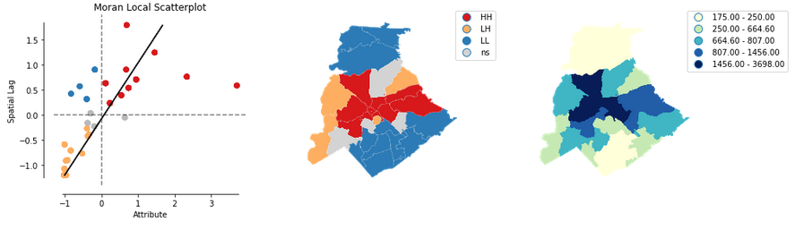
Results
HH= data and neighbors are high
HL= data is high, but neighbors are low
Heat map of hot and cold spots of cases in CLT
Uses geospatial autocorrelation (LISA) to generate analysis
Image shown is for aggregated rate of HIV cases in each zip code
Predictive model

Slide 5
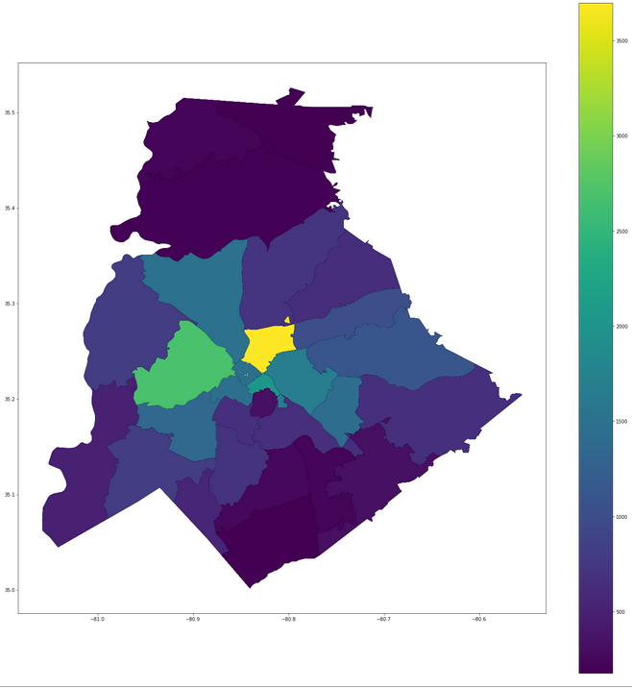
Bokeh Server Example

Slide 6
Implementation Notes
Bokeh interface provided as simple proof of concept for exploring data
Model can be deployed via flask
Model is only a POC, as the aggregate levels of data do not allow for robust levels of analysis (only 30 row of zip code level data)

